Slide 1


Anca Ionescu
Alexandra Petre
Olivia Vasile
Octavian Nedelcu
Exploratory testing

Slide 2

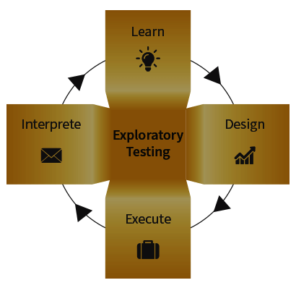
What is exploratory testing?
“Exploratory testing is an approach to testing that emphasizes the freedom and responsibility of each tester to continually optimize the value of his work. This is done by treating learning, test design, and test execution as mutually supportive activities that run in parallel throughout the project.”
Rony Wolfinzon and Ayal Zylberman

Slide 3

When to use exploratory testing
No requirements document
Short period of time
Next step is unknown
Increase test coverage
Evaluate end-user’s perspective

Slide 4

How to do it?
1. Create a bug classification
2. Create a test charter
3. Define a time box
4. Review results
5. Debriefing

Slide 5
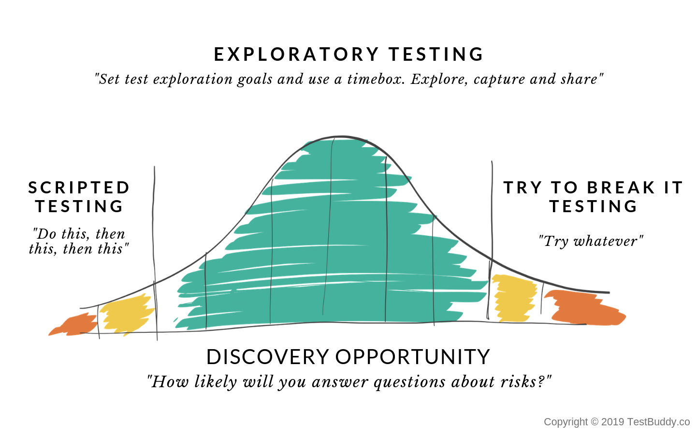


Slide 6

Differences between Scripted and Exploratory Testing
“With a script, we miss the same things every time”.
Scripted Testing
Exploratory Testing
Directed from requirements
Determination of test cases well in advance
Confirmation of testing with the requirements
Emphasizes prediction and decision making
Directed from requirements and exploring during testing
Determination of test cases during testing
Investigation of system or application
Emphasizes adaptability and learning

Slide 7
Differences between Scripted and Exploratory Testing
“With a script, we miss the same things every time”.
Scripted Testing
Exploratory Testing
Involves confirmed testing
Is about controlling tests
Like making a speech - you read from a draft
The script is in control
Involves Investigation
Is about Improvement of test design
Like making a conversation - it's spontaneous
The tester's mind is in control

Slide 8





Advantages
Rapid feedback, making quick changes
Less test preparation, saving time for execution
Effectiveness in finding critical bugs
Multi slide
Success doesn’t just find you. You have to go out and get it.
Tester's utilization, enhancing skills & flexibility

Slide 9

Further proof?
NASA has favored exploratory testing for decades!

Slide 10

Misconceptions
“Exploratory testing is not against the idea of scripting. In some contexts, you will achieve your testing mission better through a more scripted approach; in other contexts, your mission will benefit more from the ability to create and improve tests as you execute them. I find that most situations benefit from a mix of scripted and exploratory approaches.”
James Bach
Exploratory testing explained
Exploratory Testing

Slide 11
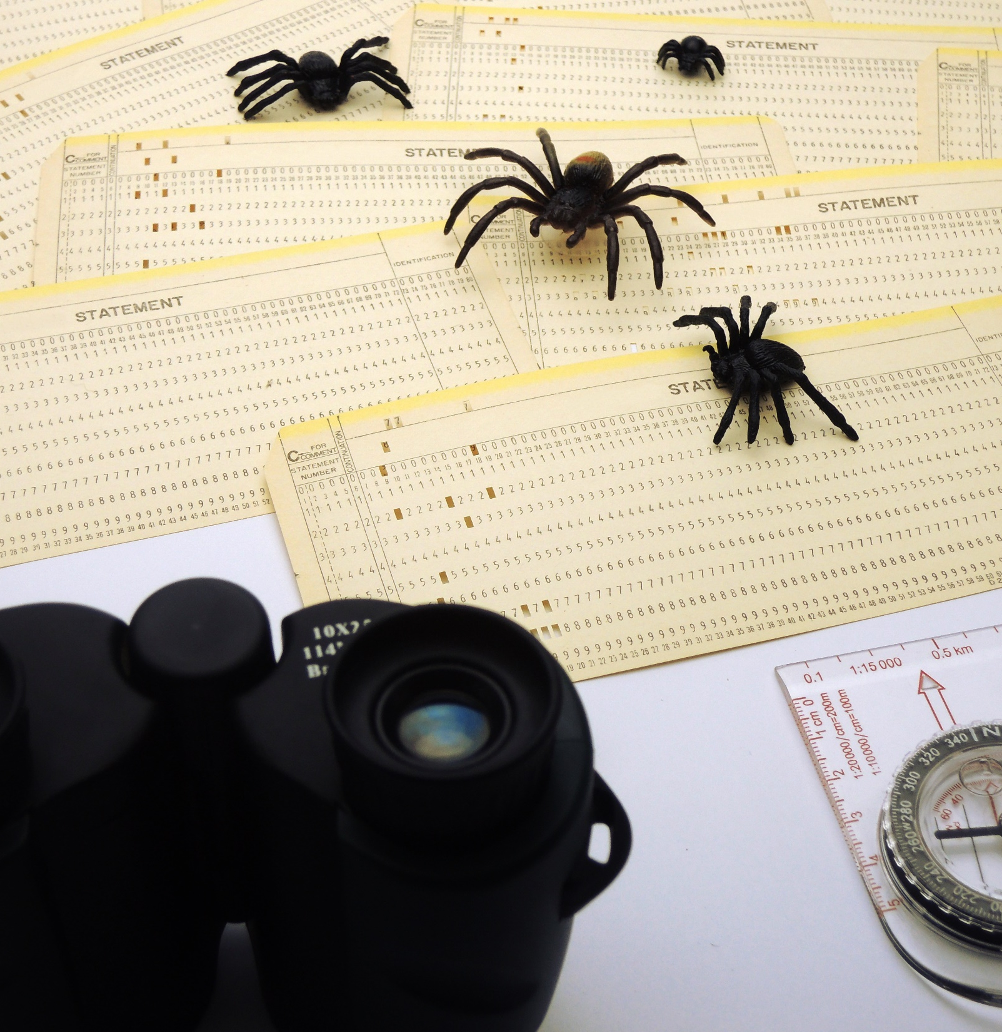

ET is an unstructured technique and does not require documentation
In fact, it can be very documentation oriented, explicitly structured, and highly rigorous

Slide 12
ET doesn’t provide complete coverage of the application
neither Scripted Testing

Slide 13

ET testers require a different skill set than scripted testers
There is no such thing as an “ET tester”
Most people that are capable of planning tests are also capable of executing Exploratory Testing

Slide 14





Conclusions
It is not a technique but it is an approach
Smple
Is not random testing
Sample
Not a replacement for scripting testing
Exploratory testing is where good testers really shine
Sample

Slide 15


Q & A
Q & A
Thank you and please, no questions! :D

Slide 16


Webografie:
https://www.tricentis.com/resources/why-exploratory-testing-matters/.
https://www.tricentis.com/blog/learning-to-embrace-confusion-in-exploratory-testing/
https://www.slideshare.net/godtesen/exploratory-test
https://www.qualitestgroup.com/white-papers/10-most-popular-misconceptions-about-exploratory-testing/
https://www.guru99.com/exploratory-testing.html
https://www.testbench.com/exploratory-testing/

